Slide 1
ICWP – Case Manager Service PA Entry Training
July 21, 2022
Presenters: Vonnie Stelly – ICWP Program Consultant
Tonja Wragg RN BSN, CCM, MHSc~ Manager Waiver Programs
d

Slide 2
Agenda
Vonnie Stelly – ICWP DCH Policy Update
Medical Web Portal DMA 80 Entry Refresher
ICWP DMA 80 – submission requirements
ICWP Case Manager– DMA 80 Entry refresher
Adding ICWP Service Procedure codes
ICWP DMA 80 New Feature: “Rendering Provider ID"
Addendums ( Change Request Feature)
Alternative Restraints
Question and Answer.

Slide 3
ICWP DMA 80 (service PA) Submission
ICWP PAs may be submitted up to 60 days before the service start date (PA effective date). For example, a PA request entered in the PA system on 7/1/2022 could be entered with a procedure ‘From Date’ starting as far in the future as 9/1/2022.

Slide 4
ICWP Case Manager DMA 80 (service) PA entry
ICWP Case Managers must have a 660 category of service and a 030 Case Management specialty in order to enter services requests.
ICWP Case Managers can now submit a single PA for up to one year date span to request all ICWP services rendered by one or more ICWP providers for a particular member
ICWP Case Managers will be provided a provider list and provider IDs for all ICWP Service Providers.

Slide 5
Service Request Web Entry
Log into Medical Review Portal
On the Secure Home page, click Enter a New Authorization, then Submit/View

Slide 6
ICWP DMA 80 (service) PA Web Entry
OR - Select Provider Workspace and then Enter a New Authorization Request.
On the next window, click request type–
ICWP DMA 80 Services.

Slide 7
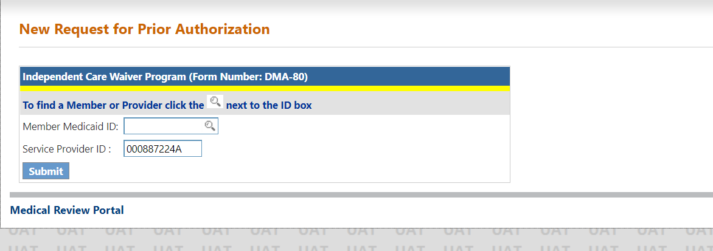
ICWP DMA 80 (service) PA Web Entry
On the next window, the ICWP provider’s ID is prepopulated based on portal login credentials.
Enter the member’s Medicaid
ID then click Submit

Slide 8
ICWP DMA 80(service)PA Entry
On the next screen, enter the approved ICWP Level of Care and Placement PA ID.
Click Submit. The system validates that the LOC is approved and is associated with the Medicaid ID.

Slide 9
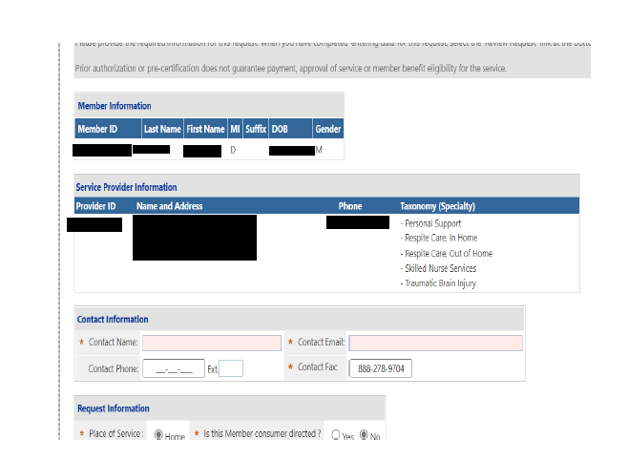
ICWP DMA 80 (service) PA Web Entry
If the LOC PA ID passes validation, the ICWP DMA 80 PA template opens with the case manager and member information prepopulated on the form.
Check the Contact Information. If any information is missing or incorrect, enter or correct the information.

Slide 10
ICWP DMA 80 (service) Pa entry – adding diagnosis code
Enter the diagnosis code for the member’s primary diagnosis related to ICWP services.
The system populates the diagnosis description.
Enter the date that the diagnosis was established; if not known, enter the date that the member started in ICWP.
Click the ‘Primary’ button and then click Add.

Slide 11
ICWP DMA 80 (service) PA entry
When Add is clicked, the diagnosis is added to the request and a new blank diagnosis line becomes available if other diagnoses need to be added

Slide 12
ICWP DMA 80 (service) PA entry
Enter the provider ID of the provider who is rendering the service. You can search for the provider ID or enter the ID manually.
If applicable to the procedure code, enter the first procedure modifier in the ‘Mod 1’ box. If there is a second modifier, enter in the ‘Mod 2’ box

Slide 13
ICWP Case Manager DMA 80 (service) PA entry
Click Add. The service is added to the PA and another blank service line becomes available to enter another service.

Slide 14
ICWP DMA 80 New Feature: “Rendering Provider ID"

Slide 15
ICWP DMA 80 (service) PA entry
In the ‘Service Code’ box, enter the procedure code for one of the services requested. The system inserts the description.
Enter the first date of service in the ‘From Date’ box and the end date of in the ‘To Date’ box.
The date span cannot exceed one year.​
Enter the total units requested for the service date span entered.
Enter the units of service requested per month.
There is no need to enter the dollar amounts.

Slide 16
ICWP Services – procedure codes added

Slide 17
ICWP Supply DMA 80s
The ICWP Supply DMA 80s will still be entered by the supply provider.
Case Managers will not be required to enter supply DMA 80s.

Slide 18
Other ICWP Service Providers
DCH will notify the other ICWP service providers of this change via GAMMIS.

Slide 19
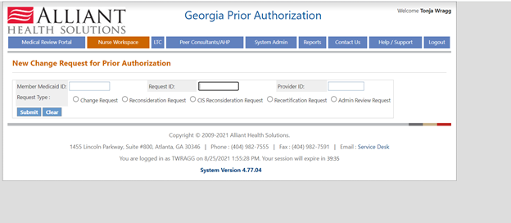
Addendums (Change Request Feature)
A change request feature is being developed in the PA system for ICWP addendums. Training will be provided in the near future once the feature is developed.
Current View for Change Requests (see screen shot below)

Slide 20
ICWP Addendums (Change Request)
Addendums (change requests) will still require completing the Appendix U and providing medical documentation as needed.
The review nurse will process all addendums and make adjustments to the service lines as needed.
□ Appendix U (Change in Condition form)
□ Completed DMA 80 if applicable for a new service or new supplies
□ Other Medical Documentation □ N/A
Please Check the name of the documents included in the Attachment before you attach. (All the files colored in red need to be attached for faster review.)

Slide 21
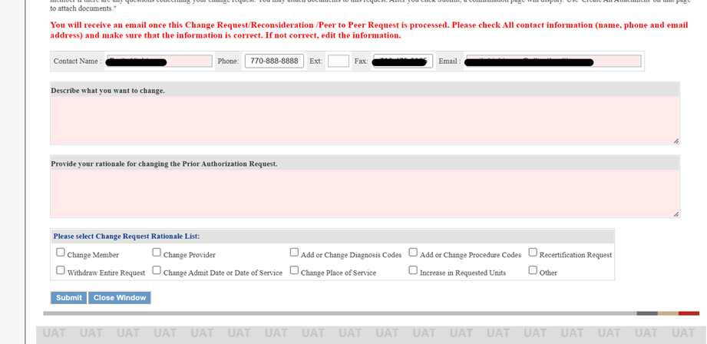
Addendum (Change request screen)

Slide 22
ICWP Case Manager Pilot Group
A small group of case managers will be asked to pilot these new features.
However, we are open to accept any volunteers to serve as the Control (Focus) Group

Slide 23
Thank you
Questions

