Slide 1
ICWP – New Provider Training
November 10, 2022
d

Slide 2
Presenters:
Tonja Wragg RN, BSN, CCM, MHSc Manager Waiver Programs
ICWP/Source/CCSP/NOW/COMP
Vonnie Stelly
Department of Community Health ICWP Program Consultant

Slide 3
New Provider Training Agenda
I. Introductions
II. DCH Updates – Vonnie Stelly – ICWP Program Consultant
III. ICWP Program Application and Admission Process
IV. Initial Assessments and Admission Process
Money Follows the Person
Medicaid Eligibility/DMA 6 Completion
Case Management Documentation and Oversight
Consumer Directed Care
ICWP Services: CM,PSS, Respite, Adult Daycare, Addendums, Skilled Nursing, Addendums, Home modifications, Alternative Living Services
New DMA 80 Entry Requirements
ICWP Addendum Submission Process
ICWP Skilled Nursing Services
Home Modifications
ICWP ALS Services
Definition of Variance
Discharge Process
Non-compliance
Waiver Transfers
Required Documentation/UCR Requirements
Use of Alternative Restraints
Provider Enrollment
Alliant Health Solutions Contacts
DCH Contacts
Billing Webinar Information

Slide 4
About Alliant Health Solutions
Alliant Health Solutions (AHS) is a division of Alliant Health Group, a nonprofit family of companies that provides professional services supporting the effective administration of healthcare programs and funding to support healthcare improvement initiatives.
AHS provides federal and state government entities with the services, expertise, and information systems necessary to increase the effectiveness, accessibility, and value of health care.
As a leading provider of innovative health solutions, AHS’ services include utilization management, program integrity, and quality improvement.
For more information about AHS and our efforts to improve healthcare quality, visit allianthealth.org.
Notes:
Founded in 1970, the Georgia Medical Care Foundation (Alliant - GMCF) is a not-for-profit, 501(c) (3), physician sponsored organization governed by the Alliant-GMCF Board of Directors. The organization is engaged in providing medical peer review services, utilization and quality of care review services, and health care outcomes research for a variety of government health care programs. With over 50 years of experience, Alliant -GMCF is recognized as an expert in these and other areas. Alliant- GMCF currently employs a staff of over 100 individuals including physicians, registered nurses, health care administrators, epidemiologists, biostatisticians, and data analysts. Alliant GMCF maintains a clinical consultant roster of over 300 actively practicing Georgia physicians, pharmacists, dentists, and allied health professionals who represent 50 medical specialties, and who are utilized to support company contracts and projects. Alliant- GMCF has been accredited by the Utilization Review Accreditation Commission (URAC) since 1996. We recently changed our name to Alliant Health Solutions (AHS) in 2017.
Alliant Health Solutions (AHS) is presently under contract to provide the following services in Georgia:
Medicare Quality Improvement Program Activities
Medical Peer Review for the Medicare Program
Medicaid Prior Approval / Utilization Management Review
Medical Review for Medicaid Waiver Programs
Nurse Aide Training Program / Nurse Aide Registry Oversight
Medicaid Surveillance and Utilization Review
Medicaid Suspended Claims and Prepayment Review
Maintenance of the Medicaid Medical and Agency Referral Network
Administrative Service Organization/Utilization Compliance and Review for MRWP/CHHS, ICWP, GAPP, SOURCE, CCSP and CSB

Slide 5
Purpose and Goals of the Waiver
The purpose of ICWP is to decrease or avoid institutionalization and offer an appropriate service to consumers that are physically disabled or has a traumatic brain injury (TBI).
To provide quality services
To provide cost effective service
To involve member and member’s representative
To demonstrate compassion for those served

Slide 6
DCH ICWP Medicaid Providers
Review and Remain Current on Medicaid Policy
Part I Medicaid and Peachcare for Kids Manual
Part II Policies and Procedures for Independent Care Waiver Services
Part II Policies and Procedures for Alternative Living Services for Independent Care Waiver Services
Manuals are updated quarterly: January, April, July, October
Providers are required to remain in compliance with Medicaid policies and procedures

Slide 7
Mandated Reporting
Report abuse, neglect, or exploitation of an adult
Adults residing in a long-term care facility (i.e. community living arrangements, personal care homes, intermediate care or skilled nursing homes), contact the Department of Community Health, Healthcare Facility Regulation, 1-800-878-6442 or http://dch.georgia.gov.
Adults living in their homes or other community settings
Call Toll-Free: 1-866-55AGING (+1 866-552-4464)
Press "3"
or file a report on the web.

Slide 8
Changes to your Information (ICWP)
Examples of potential changes: address, phone number, ownership, banking info, staff contact person, etc…
Report changes within 10 days using the “Change of Information form” in GAMMIS
Upload the required documentation into the GAMMIS system
If you are an EDWP provider, report the change to ccsp.messages@dch.ga.gov
Note: additional locations require an expansion application in GAMMIS

Slide 9
Case Manager Training
New Case Managers must complete DCH case management training modules within sixty days of approval.
Contact hcbs.casemanagement@dch.ga.gov to register and enroll for the training modules
Once you have completed the modules they do not need to be repeated

Slide 10
Incident Report System
All HCBS Providers must report Incidents
Examples: Abuse, Neglect, Exploitation, Falls, ER visits, Hospitalizations, and many more.
Existing Providers do not need to repeat the training
Case Managers-designate a contact and send to me
Training information: https://medicaid.georgia.gov/programs/all-programs/waiver-programs/hcbs-incident-reporting-system-resources

Slide 11
EVV- Electronic Visit Verification
For ICWP only PSS Providers currently required
Your new ICWP Medicaid Provider number must be registered in the EVV system
For Information, Training, Checklist, Questions visit https://medicaid.georgia.gov/programs/all-programs/georgia-electronic-visit-verification-evv/evv-service-providers
ICWP PSS unit rates are hourly and rounding rules apply

Slide 12
Billing
New ICWP Provider Billing training (required even if you currently bill for another waiver): Billing Training is required for all new ICWP Providers even if you are already billing for another waiver. Billing for ICWP Medicaid is different and you must attend the DXC New ICWP Provider Billing training. The next DXC billing training webinar are listed below.
Gainwell Technologies – Provider MMIS New Biller Training Thursday, August, 11, 2022 at 1:30 pm est.
Here is the link: Webinar access link: https://gainwelltechnologies.webex.com/meet/ICWP
This link will not work until the day of starting at 1:30pm.

Slide 13
Stay in Compliance
Review policy manuals quarterly
Monitor GAMMIS for Provider Messages and Notices. Banner messages are displayed automatically but if you are not the staff member that is using GAMMIS regularly you may not see Banner Messages. Manually review: GAMMIS site, do not log in, click on provider information, then messages and notices https://www.mmis.georgia.gov/portal/Default.aspx?tabid=21&sessionredirect=true
Monitor the DCH website for information and news at: https://medicaid.georgia.gov/
Follow us on twitter at: https://mobile.twitter.com/gadch
And Facebook at: https://www.facebook.com/gadept.communityhealth

Slide 14
On behalf of the Department of Community Health
Thank you for becoming an ICWP Medicaid Provider!
Vonnie Stelly vstelly@dch.ga.gov
ICWP Program Consultant

Slide 15
COVID-19 – TeleHealth Guidelines
Appendix K Implementation - In response to the COVID-19 State of Emergency, the Department of Community Health is waiving certain policies related to telehealth / telemedicine to support the use of telehealth in diagnosis and treatment.
Expansion of the use of telehealth will be supported by:
Waving the telehealth services originating site limitations.
Allowing telehealth services to be provided during the period of COVID-19 emergency response by the following modalities:
Telephone communication
Use of webcam or other audio and video technology
Video cell phone communication
** Refer to Department of Community Web site to review manual for COVID-19 TeleHealth Guidelines.
Notes:
. This is in response to the viral pandemic and to provide continuity of services and treatment with reduced risk of exposure to Medicaid members and providers.

Slide 16
COVID-19 TeleHealth Guideline
ICWP care plan documents (including the DMA 6) – If you are not able to meet with member in person, it is ok to write “UNABLE TO SIGN DUE TO COVID-19” on documents. However, once the Appendix K is lifted you will be required to make “in person” visits.
The DMA 6 must have a MD signature and Case Manager – no exceptions.

Slide 17
COVID-19 – TeleHealth Guidelines
The Appendix K temporary changes to services due to the pandemic was renewed until January 15, 2023. Everything that was in the original approval was renewed except for retainer payments.
If the Federal Public Health Emergency ends, the temporary changes may end but with a time period to transition back to regular face to face services.
Relatives with legal liability for members will no longer be able to be caregivers. Once that happens DCH will send out specific guidelines.

Slide 18
DCH COVID -19 Response and HCBS Operations
The health and well-being of the Department of Community Health’s (DCH) members, their families and its providers are of paramount importance.
The following is specific guidance related to the daily operations of Home and Community Based Service providers including work performed under the Money Follows the Person grant during the Coronavirus disease 2019 (COVID-19) period. Whereas, CMS guidance gives focus to management of those individuals with COVID-19 and mitigating potential risks through contact, within healthcare facilities and patients under home isolation; this guidance will discuss ongoing work performed within member’s homes, Home Delivered Meals, Adult Day Health facilities and screening/assessments within nursing facilities.
The COVID-19 Public Health Emergency is expected to remain in place until January 15, 2023.
Healthcare providers who suspect COVID-19 infection in a patient should report them immediately to DPH by calling 1-866-PUB-HLTH (1-866-782-4584) and ask for a Medical Epidemiologist.

Slide 19
DCH COVID -19 Response and HCBS Operations
Case Management Agencies
Home Visits - Case managers may continue to use telephonic means by which to perform monthly client contact. However, they can conduct home visits utilizing appropriate PPE and following CDC guidelines during the visit.
Documentation must occur in formal notes, note type should equal “monthly client contact”.
Additional guidelines for case management agencies may be provided based on the Waiver the patient utilizes.

Slide 20
DCH COVID -19 Response and HCBS Operations
Private Homecare
The Personal Support Service (PSS) provider is to assure that aides provide services as scheduled. PSS providers are instructed to provide staff with Personal Protective Equipment (PPE) and to follow CDCs prevention steps as you work with members.
During your visit, if you notice any signs or possible symptoms staff should immediately implement recommended infection prevention and control practices. If a member is suspected of having COVID-19, they should also notify infection control personnel at their agency and the state or local health department if a member is classified as a PUI for COVID-19.

Slide 21
DCH COVID -19 Response and HCBS Operations
Adult Day Health Facilities
The state will leave the decision to remain open and/or to utilize services to the providers, members and family members. Please monitor members for possible symptoms and notify the DPH of any concerns. If the Governor or the President declares a State of Emergency, DCH will notify ADH providers to cease operations for the instructed period of time.
All other providers please use best professional judgement if you are required to visit a member’s home.
Providers are encouraged to use if applicable, telephonic and/or electronic visual tools to remain in contact with members.
DCH will provide up to date information as it is received via Banner Messages on the GAMMIS provider portal and through the DCH website.
Please note that the Department of Public Health is the lead agency for any information for Infection control for general reference and guidance. https://dph.georgia.gov/

Slide 22
ICWP Program Application Process
The ICWP Application can be found on the Department of Community Health website.
Applications can be emailed Tara.Smith@alliantASO.org and 678-527-3001 (fax).
Applicants must be between the ages of 21-64. If they are turning 65 within 6 months the year they apply, they will be referred to Source or CCSP.
An ICWP Review nurse will contact the applicant within 10 business days for screening and to schedule time for an assessment.

Slide 23
Budget Overview for ICWP
The current budget for nursing facility level of care is $94,888
The current budget for hospital(skilled ) level of care is $220,762
Overall supply budget of $12,312 that can be incorporated within the overall budget if deemed medical necessary.
This was determined by CMS (Centers for Medicare and Medicaid) and the GA State Department of Community Health.

Slide 24
ICWP Initial Assessment
CMS has approved some aspects of telemedicine for community health. ICWP assessments can be conducted via video or “in person.”
The ICWP application is screened by the review nurse to determine if an assessment is warranted or justified based on pre-assessment criteria such as: primary diagnosis or willingness to apply for Medicaid if they do not currently have Medicaid

Slide 25
Level of Care Determination
The ICWP Medical Review nurse will determine the level of care at the time of the initial assessment.
If the applicant is approved, the review nurse will develop a care plan that will include but not limited too the following ICWP services:
Case Management
Personal Support and Respite
Alternative Living Services
Medical Supplies or equipment
Adult Day Care
Environmental Modification – New provider in the process of being approved.
Behavioral Counseling – Currently no active ICWP providers
The services will be implemented by the ICWP Case Manager once the member is awarded a slot.

Slide 26
Initial Participant Assessment form
The Initial Participant Assessment form is designed to capture pertinent information needed for initial assessments.
This form will be completed by the ICWP Medical Review nurse during the initial assessment.
Initial assessment documentation is shared with ICWP case managers once the applicant accepts a slot and is ready to start ICWP services.
Appendix D-4 in the ICWP policy manual.

Slide 27
ICWP Waiting List
The applicant is placed on a waiting list if they are approved after the initial assessment.
They will be mailed a “waiting list” approval letter via certified mail.
Waiting list approval does not guarantee services. The person must be on Medicaid to receive services through the ICWP program.

Slide 28
No Waiting List
Currently ICWP has no waiting list. Once an applicant is assessed and approved, they will receive an official approval letter along with the ICWP Case Manager list.

Slide 29
ICWP Admission and Slot Approval
The applicant will receive a “slot approval” letter and a case manager list to choose case manager.
There are two categories of case managers: traditional and enhanced. Review ICWP Policy Section 902.1 for enhanced case management qualifications.
The ICWP Case Manager will coordinate the admission to the program.
ICWP Case Manager will notify all ICWP providers when services can start.

Slide 30
New Admission Process
Here is our current process for New admissions:
If the initial assessment was completed less than 6 to 9 months before the admission, we require a new admission narrative along with required care plan documents.
If the initial assessment was completed up to 10-15 months prior, we require a RPAF which includes a detailed narrative to make sure no major changes have occurred since the initial assessment.
Initial assessments completed more than 15 months prior will require a re-application for an assessment.
**Service Providers DO NOT start services until you receive notification from the ICWP Case Manager

Slide 31
Money Follows the Person
Designed to assist persons who want to transition out of the nursing home.
Case managers will need to actively assist in the transition. Verify the member will qualify for community Medicaid, and work with NH to coordinate that services are in place when member goes home.
MFP only follows member for 1 year.
All MFP services will eventually be transferred to the Elderly and Disabled adults waivers: Source, CCSP, and ICWP.

Slide 32
ICWP Admissions – Money Follows the Person - MFP
ICWP Case Managers should work directly with the MFP coordinator, nursing home social worker, and the member’s circle of natural support prior to transitioning from the nursing home to the community through the MFP program.
The member must have active ICWP Medicaid before ICWP services can start.

Slide 33
Medicaid Eligibility
The case manager can submit the following to assist member will applying for Medicaid:
-- Member must apply on line.
-- Member’s PCP much complete a DMA 6. The DMA 6 must be signed by the MD, member, and ICWP Case Manager
-- The ICWP case manager will send a completed DMA 6 to Alliant Health Solutions to receive a temporary DMA 6 in lieu letter.
-- The temporary “in lieu” letter, completed DMA 6 and the ICWP communicator form should be completed and submitted to DFCS by the ICWP Case Manager. The ICWP Communicator form is found in the policy manual.

Slide 34
DMA 6 Completion
DMA 6 completion requires the following signatures:
Member Signature and date
MD Signature and date
Case Manager Signature and date.
DMA 6 for New Admissions
Send a copy of the completed DMA 6 to AHS to receive a temporary DMA 6 In lieu letter. The start date indicated on the temporary “in lieu” letter will be the care plan start date for new admissions. Otherwise their care of plan start date will be the date AHS receives a complete careplan attached to a ICWP DMA 6 Prior Authorization in the web portal.

Slide 35
DMA 6 Completion
Renewal Care plans
All Signatures required. Ok for MD to sign 60 days before care plan due date. We can no longer accept care plans after the end date of the previous year.

Slide 36
DMA 6 Completion
Here are the guidelines approved for DMA 6 signatures when the member is unable to sign:
Print the member’s name on the signature line of the DMA 6
Date and Initial followed by CM name to reflect the case manager and member were present at the time of printed name.
On a separate sheet of paper to be attached to the DMA 6, the case manager will write the name of the member and that the member is unable to sign and a proxy is not available. The case manager will sign, date, and attach the additional sheet of paper to the member’s DMA 6.
(show example)

Slide 37
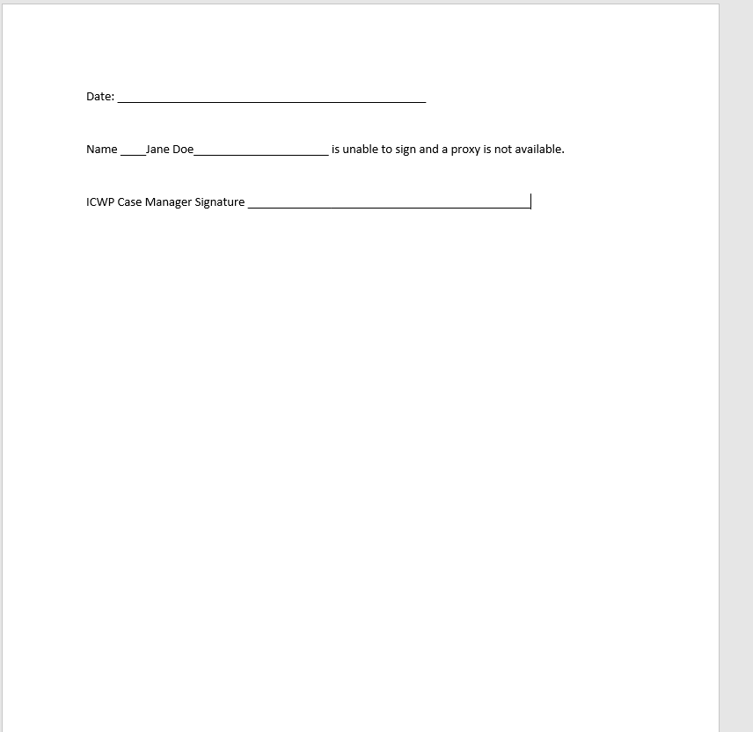
DMA 6 Completion (Member not able to sign)

Slide 38
ICWP Care Plan and Implementation of Services
An ICWP admission care plan must be submitted by the ICWP Case Manager.
The Appendices section of the ICWP policy manual includes care plan documents and procedure codes for service providers.
The ICWP Policy manual has all of the required care plan documents available in word format.
NEW – ICWP Case Managers will enter (1) DMA 80 for all providers to bill. Each service will have a line with their procedure code for billing. The ICWP case manager will share the DMA 80 PA and care plan documents with each service provider for that member.

Slide 39
Electronic Signatures
While we the PHE is in place, DCH will allow some exceptions when it comes to the member signature. The case manager can write “UNABLE TO SIGN DUE TO COVID 19” for the member’s signature if the member is not allowing visits to the home. However, there are no exceptions for the case manager signature and MD signature. We do not accept “typed” signatures. AHS will accept an electronic signature if it has the following format:

Slide 40
Case Management
Must conduct a face –to-face monthly assessment of each member
Develop a Plan of Care for each member
Maintain progress notes for each member
Coordinate care with the physician when needed
Required to go over the Memorandum of Understanding
Report any abuse or neglect
Submit all documentation to AHS timely
Coordinate care with all service providers; and ensure those providers have the required information to use the electronic system.
Try not to admit members until you have an understanding of ICWP

Slide 41
Traditional Case Management Billing
Max of 10 hours per month
Each 15 minutes equals 1 unit
480 units max for the care plan year.
10h x 4u= 40 units each month
40 x 12 months= 480 units
480 units x $6.88 each = $3302/yr

Slide 42
Enhanced Case Management Billing
Max of (1) hour/unit per month
12 units max for the care plan year.
(1) unit per month x 12 months= $507.10

Slide 43
Case manager: CDC Certification
CDC - The member agrees to be the employer.
CM’s will need to contact Tonja Wragg to provide the CDC material you will need for testing purposes.
Email Tonja.Wragg@AlliantHealth.org to schedule a CDC certification test to manage clients on CDC.
Highly recommended that CM’s become familiar with enrollment process with the Fiscal Intermediary Agent.

Slide 44
Renewal Participant Assessment (RPAF) Form
A Renewal Participant Assessment form (RPAF) has been designed for case managers ONLY to be completed when the care plan is renewed.
All ICWP case managers must use this form and should have an editable copy. The editable version can be found in the ICWP manual.
The RPAF should be completed at each renewal and new admissions that are between 9 to 15 months after the initial assessment.

Slide 45
ICWP Community Care Path Completion
ICWP annuals, quarterlies, and variances are being entered electronically into Alliant’s long term care database.
The first page of the community care path can be used as the signature page for the quarterlies you have completed during the course of the year.
Take this page with you during each quarterly visit to obtain the member signature.
When you submit your renewal care plan for AHS approval, the first page of the community care path should be this document.

Slide 46
Personal Support Services
Level 1: services are provided to members requiring moderate to total assistance with ADL’s. Rate: $19.76
Level 2: services are provided to members requiring total assistance with all ADL’s and are receiving some form of technology dependent care such as (ventilator, trach, g-tube). Rate: $22.22
*** Companion services can be included as in-person support at no extra cost to the member.

Slide 47
Personal Support Pay Rate
Effective July 1, 2021, the Department of Community Health approved a pay rate increase for all levels of personal support:
PSS Level I -- $19.76
PSS Level II -- $22.22
Hours are based on need and budget level
Levels may be split according to members needs and budget levels
When entering procedure codes ensure use of correct modifiers – Appendix O section of policy manual has the Procedure codes with modifiers
NOTE: 1 hour of service equals 1 unit.
8 hours x 365 days= 2920 units
2920u X $19.76(level I)= $57,699.20/yr
2920u x 22.22 (level II) = $64,882.40/yr

Slide 48
Respite Care
The purpose is to provide temporary relief for the individual(s) normally providing care
This service will pay for up to 240 units per month (60 hours). It is limited to 1440 units per year (360 hours per year).
NOTE: Unit of service in 15 minutes.
Entry is done on a separate PA from PSS.
EX: Respite Level I S5150 (2) hours x 4= 8 units x $2.86 ( new rate) each = $22.88
Members on CDC option cannot receive respite hours. Approved PSS hours must be altered to provide extra care as needed.

Slide 49
Example of Respite Request
ICWP Member has an appointment outside of the home:
Respite hours can be used to assist the primary caregiver with the member once the member returns home. The bulk of the personal hours would have been used when the aide accompanied them to their appointment. The aide will be need to stay longer to assist with getting them ready for the night.
In order to document a respite request according to how “in home” respite should be used here is an example of how it can be written:
“Member has an appointment on (date), he/she will need extended hours of assistance once he/she returns from their appointment. The member is requesting, ___ hours of respite to cover the time the pss aide will be needed to assist at home after the appointment because the primary caregiver will not be available. (or you can write “the primary caregiver has limited availability”)

Slide 50
Adult Day Care
A member can receive adult day care and personal support if services remain under the current nursing home level of care or hospital level of care budget.
There are currently 11 adult day care providers throughout the state.

Slide 51
DMA 80 Approvals
We are no longer required to enter ($) amount for an approved DMA 80. Claims will pay based on the new unit rates.

Slide 52
ICWP Case Manager DMA 80 (service) PA entry
ICWP Case Managers must have a 660 category of service and a 030 Case Management specialty in order to enter services requests.
ICWP Case Managers can now submit a single PA for up to one year date span to request all ICWP services rendered by one or more ICWP providers for a particular member
ICWP Case Managers will be provided a provider list and provider IDs for all ICWP Service Providers.

Slide 53
Service Request Web Entry
Log into Medical Review Portal
On the Secure Home page, click Enter a New Authorization, then Submit/View

Slide 54
ICWP DMA 80 (service) PA Web Entry
OR - Select Provider Workspace and then Enter a New Authorization Request.
On the next window, click request type–
ICWP DMA 80 Services.

Slide 55
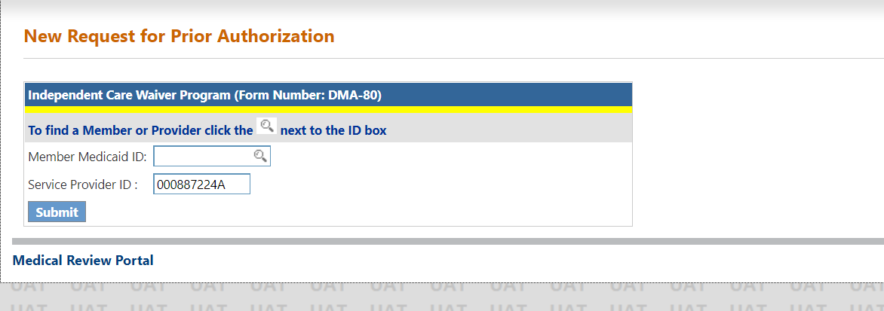
ICWP DMA 80 (service) PA Web Entry
On the next window, the ICWP provider’s ID is prepopulated based on portal login credentials.
Enter the member’s Medicaid
ID then click Submit

Slide 56
ICWP DMA 80(service)PA Entry
On the next screen, enter the approved ICWP Level of Care and Placement PA ID.
Click Submit. The system validates that the LOC is approved and is associated with the Medicaid ID.

Slide 57
ICWP DMA 80 (service) Pa entry – adding diagnosis code
Enter the diagnosis code for the member’s primary diagnosis related to ICWP services.
The system populates the diagnosis description.
Enter the date that the diagnosis was established; if not known, enter the date that the member started in ICWP.
Click the ‘Primary’ button and then click Add.

Slide 58
ICWP DMA 80 (service) PA entry
When Add is clicked, the diagnosis is added to the request and a new blank diagnosis line becomes available if other diagnoses need to be added

Slide 59
ICWP DMA 80 (service) PA entry
Enter the provider ID of the provider who is rendering the service. You can search for the provider ID or enter the ID manually.
If applicable to the procedure code, enter the first procedure modifier in the ‘Mod 1’ box. If there is a second modifier, enter in the ‘Mod 2’ box

Slide 60
ICWP DMA 80 New Feature: “Rendering Provider ID"

Slide 61
ICWP Supply DMA 80s
The ICWP Supply DMA 80s will still be entered by the supply provider.
Case Managers will not be required to enter supply DMA 80s.

Slide 62
Addendums
Submitted by the Case Manager
Requests for additional supplies, personal support, skilled nursing hours, respite hours, and home modifications
Include DMA 80 for the service provider
CM’s complete addendum form (Appendix U - change of condition/addendum form) when requesting additional PSS hours or extra services. ( see attachment)
Indicate in a narrative what has changed in the client’s life to justify the request.

Slide 63
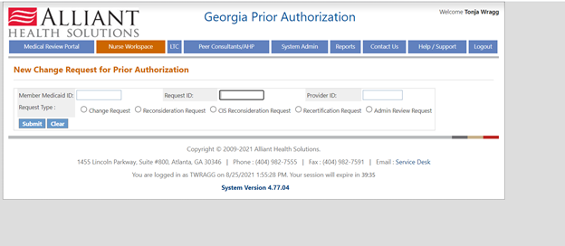
Addendums (Change Request Feature)
A change request feature has been developed in the PA system for ICWP addendums. Training materials will be provided for your review
Current View for Change Requests (see screen shot below)

Slide 64
ICWP Addendums (Change Request)
Addendums (change requests) will still require completing the Appendix U and providing medical documentation as needed.
The review nurse will process all addendums and make adjustments to the service lines as needed.
□ Appendix U (Change in Condition form)
□ Completed DMA 80 if applicable for a new service or new supplies
□ Other Medical Documentation □ N/A
Please Check the name of the documents included in the Attachment before you attach. (All the files colored in red need to be attached for faster review.)

Slide 65
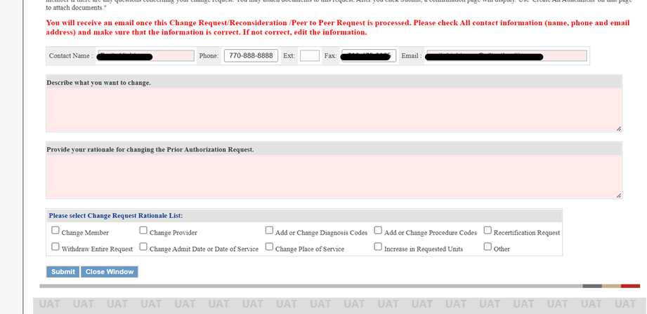
Addendum (Change request screen)

Slide 66
Appendix U - Change in Condition/Addendum

Slide 67
Addendums
New addendum needed for each request
Cm to submit to AHS for approval before notifying the provider to render services unless it is an emergency situation
Explain to client that increases are not always guaranteed
CM should attempt to find other resources before submitting an addendum.

Slide 68
ICWP Skilled Nursing Services

Slide 69
Skilled Nursing Services
New admissions:
During the initial assessment, an Alliant medical review nurse approves skilled nursing hours and it is added on the financial summary. At the time of the assessment, the review nurse will know if skilled nursing should start Home Health. Home Health is paid through straight Medicaid and does not add any costs to the overall ICWP budget.
ICWP Skilled Nursing hours will not be approved for services such as wound care until Home Health skilled nursing has been exhausted.
However, Home Health will not be able to implement skilled nursing in the same manner for vent or trach patients. Members with vents or trachs may need to begin services with a regular ICWP Skilled nursing agency on admission. (See instructions if ICWP skilled nursing hours is needed instead of Home Health).

Slide 70
Home Health Nursing Services
New admissions:
When transitioning from a nursing home or hospital, the facility case manager or social worker will secure a Home Health provider if the member requires wound care. The MD will order the home health prior to the member leaving the facility.
The Home Health agency will proceed with the evaluation and skilled nursing based on the MD order. These services are paid through straight Medicaid and NOT ICWP.
The Home Health skilled nursing agency will send a copy of their nursing evaluation to the case manager.
The case manager will send it to the review nurse.
The case manager and Home Health nursing agency should work together when sending in quarterly updates.
The case manager can request a copy of what they are required to keep in the clinical record according to policy and send it to the review nurse

Slide 71
ICWP Skilled Nursing Hours
New admissions with Home Health
Home Health will continue based on an MD order.
The ICWP case manager can request additional ICWP skilled nursing hours once Home Health has been exhausted with straight Medicaid.
New Admissions for ICWP Skilled Nursing Hours with an ICWP Skilled Nursing Agency
Alliant Medical Review nurse can approve skilled nursing hours during the initial assessment. An ICWP Skilled nursing hours allotment form is completed the AHS medical review nurse to determine the number of skilled nursing hours for LPN or RN. The ICWP Skilled Nursing hours will be added to the overall budget. (The ICWP Skilled Nursing Hours Allotment form is an internal document only)
There is no need to add a separate cost for an RN skilled nursing evaluation because, the evaluation is all inclusive for the agency for any approved ICWP Skilled Nursing hours.

Slide 72
ICWP Skilled Nursing
New Admissions for ICWP Skilled Nursing Hours with an ICWP Skilled Nursing Agency (continued)…
The case manager will secure an approved ICWP Skilled Nursing provider on admission.
The ICWP Skilled Nursing agency will send their initial evaluation to the case manager to send to the review nurse.
The review nurse will enter the DMA 80 for the ICWP skilled nursing agency with the approved skilled nursing hours.
Quarterly evaluation and updated MD order submitted by the skilled nursing agency – case manager will need to send this to the review nurse. ~ICWP policy manual section 902.3: A plan of care signed and dated by the attending MD at least every (90) days or every (3) months that includes drug, dietary, treatment and activity orders.

Slide 73
ICWP Skilled Nursing
Addendums for ICWP Skilled Nursing Hours with an Agency or Home Health
The Case manager should request Home Health first through the members PCP for skilled nursing such as wound care. Home Health bills straight Medicaid so we will not enter a DMA 80 for their services.
If the addendum request(Appendix U) for skilled nursing hours is for anything other than wound care, the review nurse will review the addendum and determine if ICWP skilled nursing hours for LPN or RN is warranted.
Make sure to document on the addendum form (Appendix U) if Home Health services has been exhausted when warranted.
If approved, the ICWP case manager will secure and ICWP Skilled nursing agency. The ICWP Skilled Nursing agency will send their initial evaluation to the case manager to send to the review nurse

Slide 74
ICWP Skilled Nursing
The ICWP review nurse will complete the ICWP Skilled Nursing Allottment form (internally)based on the skilled nursing evaluation completed by the agency.
The review nurse will enter the DMA 80 for the ICWP skilled nursing agency with the approved skilled nursing hours. There is no need to enter a separate PA for a skilled nursing evaluation because that is all inclusive with the agency providing the skilled nursing hours.
Quarterly evaluation by skilled nursing agency – case manager will need to send this to the review nurse. (same as above with new admissions).

Slide 75
ICWP Skilled Nursing
Note:
Home Health and ICWP skilled nursing cannot be done simultaneously. Home Health will start first over ICWP skilled nursing when a person is being discharged from a facility with an MD order for wound care.
It is easier for them to transition in that manner. Once they get into the community we can follow our process for implementing ICWP skilled nursing.
The case manager will need to connect the skilled nursing agency and the home health so they can coordinate discharge and obtaining an MD for the ICWP skilled nursing.
My suggestion is to use Home Health as much as possible if the MD has already ordered it from the hospital or nursing home.
We can always add our skilled nursing hours once the Home Health visits have been exhausted.

Slide 76
ICWP Skilled Nursing Procedure Codes (Appendix O)
 |  | Procedure Code | Modifier | Rate
Skilled Nursing Visit | Skilled Nursing visit | T1030 |  | $54.77
Skilled Nursing Visit | Skilled Nursing visit | T1030 | U1 | $54.77
Skilled Nursing (RN) | Skilled Nursing (RN) | S9123 | TD | $11.00
Skilled Nursing (RN) | Skilled Nursing (RN) | S9123 | U1 TD | $11.00
Skilled Nursing (LPN) | LPN Nursing | S9124 | TE | $9.63
Skilled Nursing (LPN) | LPN Nursing | S9124 | U1 TE | $9.63

Slide 77
Home Modifications
Home modification requests are typically initiated during the initial assessment. However, some requests come from members already enrolled in ICWP.
ICWP Policy Manual Section 902.5 provides details on the home modification completion process.
The process is initiated and completed by the ICWP Case Manager.

Slide 78
Home Modification Budget
The Maximum amount approved for home modifications is $8800 (new).
This was determined by CMS (Centers for Medicare and Medicaid) and the GA State Department of Community Health.

Slide 79
Per Policy: 902.5 Environmental Modification
Environmental Modification services provide physical adaptations to the home, specified in the Individual Plan of Care, which are necessary to ensure the health, welfare and safety of the member, or which enable the member to function with greater independence in the home and, without which, the member could require institutionalization.
Some rental properties are allowed if they are stable. Please check with the review nurse to coordinate a home modification on a rental property.

Slide 80
Home Modifications
All adaptations and improvements must receive prior approval before work is initiated.
Home can be owned by member or member’s family. Some rental properties will be allowed.
Estimates from a contracted ICWP home modification provider.
Take pictures of the job before, and after to submit to Alliant Health Solutions ( AHS) for review.
Create a contract of the work to be completed- signed by contractor, client, and homeowner if it is not the client, and case manager
Notify AHS when the job will begin; send DMA 80; review nurse will approve ½ payment to start work.

Slide 81
Role of ICWP Case Manager for Project Oversight:
The ICWP case manager should create a contract that specifically explains the work that will be completed. The member, case manager, and building contractor must sign an agreement indicating the specific home mod, estimate, start date, and expected completion date.
The case manager functions as a neutral party that is familiar with the layout of the home. They have seen the home in it’s before and after state. In the event of any dispute, the case manager will attempt to mediate the dispute and provide an assessment of the work completed. The ICWP Case Manager’s assessment of the completed home modification is part of the review and approval process and, if needed, any litigation process.
The case manager should make arrangements to conduct periodic visits if possible during the remodeling so that any areas of concern can be addressed. However, AHS recognizes that these projects are fast moving and will often be completed within 1-2 weeks of start date. The case manager should make every effort to contact the member by phone to receive a progress report of work being done.

Slide 82
Role of the Case Manager (continued)
Rationale: There have been complaints in the past of members feeling bullied or intimidated into signing when presented with the agreement by the contractor.
Rationale: There have been complaints from contractors stating members will not release the work due to something that was never agreed on in the original contract.

Slide 83
Home Modification Approvals
The Home Modification Provider will need an approved PA to bill and receive payment.
Gainwell Technologies will review the billing process in a webinar separate from this training. AHS does not manage claims or billing.
Here are the current procedure codes for home modification billing:
S5165 and S5165 U1. The U1 modifier is used when the patient has a diagnosis of a Traumatic Brain Injury (TBI)
Note: ICWP review RN currently enters and approves the electronic DMA 80 for the contractor or home modification provider.

Slide 84
Home Modification - DMA 80 Entry
The ICWP Case Manager will send the AHS Review RN the DMA 80 from the Home Mod Provider. A copy of the DMA 80 form is found in the ICWP Manual Appendix L
Notification of when the contractor intends to start the job should be included. Also include projected amount of time to complete the project.
Submit the DMA 80 and signed contract at the same time.
The review RN will approve half of the total amount.
Remaining funds to be approved once work is completed.
The Home Modification provider’s PA should be entered as a separate DMA 80 by the review nurse.

Slide 85
Project Completion
Case Managers should coordinate their monthly visit for the completion of the work and the final sign off. It is the case managers responsibility to provide the final documents to the AHS review RN.
By submitting these documents you are agreeing that the final funds should be released to the builder.

Slide 86
Note:
AHS review RN should not be receiving completed signed documents or pictures from the builder. Everything should be submitted from the ICWP Case Manager.
The case manager will send the review RN the completed packet of information.

Slide 87
Required Documents for Final Payment
Finished pictures - The case manager should be present to see the completed work. These pictures are to show that the case manager has seen the completed work, the area looks good, safe, and usable.
Create a satisfaction of work or completed work statement. This agreement must be signed by case manager, the member and the contractor. In a perfect situation, the case manager would be present for a walk-through and witness both the member and contractor signing. This agreement indicates work has been completed, and the home is livable and useable.
Once these items are submitted, the review RN will release the final payment.

Slide 88
Home Modification Provider Issues and Concerns
Some contractors have reported they never know where their bid is in the approval process.
The contractor should be notified if their bid was accepted or not accepted.
Contractors are required to keep their files in order. Some contractors have reported some project proposals were submitted to ICWP case managers but have never heard any further follow up. Once a proposal/estimate has been accepted and approved by AHS. The expectation is that the contractor will complete the project upon approval but not more than 90 days.

Slide 89
Home Modification Providers Issues and Concerns
Contractors are expected to begin completion of the project as soon as possible after AHS approval. It is understood there may be others home modifications in progress.
Contractors should be informed promptly if the bid is approved to allow them time to schedule the project properly.

Slide 90
Home Modification Provider Issues and Concerns
Contractors state they need the care path packages for audits and case managers are not providing them with the needed information.
Policy states: 906. Documentation
Rev. 01/06 906.1 General Record Keeping Standards
All provider records for the member must contain a copy of the submitted ICWP care plan which will include the DMA 6. The DMA 80s are submitted electronically so paper versions are not required. However, all services should be indicated on the ICWP financial summary created by the case manager. The Mailer Data form that Gainwell Technologies sends out to providers must be attached and kept with the submitted copies of the DMA 6, and DMA 80 in the member record. This will verify approval from Alliant Health Solutions.
ICWP Case Managers should provide copies of this information to any service provider of the member if they request due to an audit.

Slide 91
Before and After Bathroom Modification

Slide 92
ICWP Home Modification Contractors
Current Home Modification Providers
R and E Health Care, LLC
Office-770-714-7279
Cellphone-470-217-8445
Fax-470-300-7778
Genesis Home Care
4751 Best Road
College Park, GA 30337
770-808-6070
ABC Installations
115 Kings Road
Athens, GA 30606
706-202-3187
The Department of Community Health is actively recruiting Home Modification Contractors

Slide 93
Short Break

Slide 94
ICWP Policy Manual and Alternative Living Services (ALS) Manual
Notes:
Show manual and how to look up specific information.

Slide 95
ICWP Policy Manual and Alternative Living Services (ALS) Manual
Please read the ICWP Policy Manual and ALS Manual to obtain a clear understanding of this Medicaid Waiver.
The ICWP Policy is updated quarterly.
Both manuals can be found in the Medicaid web portal under Policy Manuals.
The Program Consultant may occasionally send Banner messages through web portal for important notifications.

Slide 96
Alternative Living Services (ALS) Family Model
ALS Family Model is the provision of twenty-four hour supervision, medically related personal care, nursing supervision and health related support services in certain state-licensed personal care homes to Medicaid eligible individuals who are independent Care Waiver Services Program members unable to live independently in their own homes
Services are provided in a residential setting other than the member’s home
Subcontracted personal care homes provide the amount of personal care services needed by each member on a schedule that respects the member’s choice (time of day, etc.) and ensures the member’s hygiene and health needs are met
The provider agency’s RN lists personal care tasks needed by the member on the member’s care plan and supervises these tasks

Slide 97
Alternative Living Services (ALS) Family Model
The provide agency’s RN supervises the delivery of personal care services to ensure that the subcontracted personal care home delivers services appropriately and safely
Examples of a limited list of personal care services performed by the subcontracted personal care home include, but are not limited to:
Assist with basic personal care and grooming, including bathing, care of hair, clothing, ambulation and transfers

Slide 99
Alternative Living Services Policy and Procedure Manual
Refer to the Policies and Procedures for Alternative Living Services manual for a more comprehensive list of personal care services and all requirements for ALS participation.
Also, refer to Personal Care Home Rules and Regulations for appropriate personal care tasks.
Personal Care Home Rules and Regulations can be found at www.dch.georgia.gov. Click on Divisions and Offices; click on HFR; click on Rules and Regulations; click on Personal Care Homes for specific care or service requirements.

Slide 100
Alternative Living Service: Funding Structure
Funding Structure: Who collects from the member?
The room and board amount goes to the subcontracted personal care home
The room and board is presently at $689.00 and will increase to $726 in January 2023. This is collected from the member by the subcontracted personal care home
The personal care home is paid a supervision fee in the amount of no less than $46.20 per day by the provider agency. The provider agency retains $32.80 of the $77.00 supervision fee reimbursed by DCH.
The member retains funds for personal needs in the amount of their check above the room and board amount paid to the subcontracted personal care home.
The amounts to be collected and paid by whom are reflected in an agreement which is signed by the subcontracted personal care home and provider agency and approved by DCH. Both providers retain a copy.

Slide 101
How to Find an Alternative Living Services (ALS) Home Through an Enrolled ALS Provider
All approved ALS homes will be included on the healthcare Facility Regulations (HFR) list of licensed personal care home across the state.
Not all PCHs are ICWP ALS approved homes:
AHS has retains a list of ALS approved Family Model homes
Word of mouth is a most common way in which homes are identified: through families, friends, other members, and anyone in the community who knows of an ALS home.

Slide 102
Definition of Variance
For case managers - A variance in the ICWP waiver program is defined as any change in the member’s condition that has altered the plan of care.
Here is an example of a variance that will need to be entered as a Care Path Indicator Entry:
Hospitalization – This should be documented under Goal 4 from the care path goals. If it was due to a wound or UTI, you can also document information under Goal 6 and Goal 9.

Slide 103
Discharge of Services
When a client has been discharged from your company, please complete an Appendix K-1 and send it to the CM. The CM should then forward it to AHS.
The date of discharge is the last date of service.
You must provide a 30 day notice unless there are extenuating circumstances.
In the event of the client’s death, the CM enter that information into the HCBS Critical Incident Reporting System. Then submit the Appendix K-1 to the review nurse. This form is found in the ICWP Policy and Procedure manual. Please notify AHS and try to enter the death notice within 24-hours of client’s death (or their awareness of the death).
Any member without PSS services for 60days may be discharged from ICWP.

Slide 104
Out of compliance/Adverse Action
Please submit care plans no more than 60 days before the due date. Do not wait until the last minute. Once we have received a complete packet, we have 30 days to complete.
Quarterly reviews are due by the end of month of the due date. Ex: QR-January 2 submit to AHS on or before January 31.
Non-Compliance letters will be sent to CM for late care plans, not providing quarterly reviews, and failure to provide other providers with needed information to submit their electronic PA.
Receiving five or more non-compliance letters within a year may result in a DCH compliance review for disciplinary action.

Slide 105
Waiver to Waiver Transfers
At the time of the initial assessment, the AHS nurse will ask if the applicant is receiving services with another waiver. However, there may be times where the client will start with another waiver after an initial assessment has been completed.
The client and the ICWP case manager should contact the other waiver’s case manager to coordinate proper transition of services.
All services need to be notified of the transition, i.e. meals on wheels, personal support services, ERS, etc.
ICWP will begin services on the 1st of the following month to reduce risk of billing conflicts.
Problems (Edits) will occur if the original waiver continues to bill even after ICWP is set to start.
ICWP Case Managers should ask for a Waiver transfer form from the Source or CCSP care coordinator.

Slide 106
Electronic PA Entry
DMA 6 PA number is required to enter any DMA 80’s.
The DMA 6 can be entered by the CM but can only be approved by the AHS review nurse.
Once the 6 is approved the CM will enter one PA and add the service line for each rendering provider. All providers will bill from the same DMA 80 based on their procedure code.

Slide 107
ALL Providers are Required to Document Care Provided to a Member
Providers are required to document care rendered to a member.
Services rendered to a member should be related to the hours billed.
Be prepared to submit all documentation to support any claims that member has acted inappropriately, in an abusive manner, or in a dangerous manner.
ALL ICWP CASE MANAGERS MUST PROVIDE A COPY OF THE MEMBER’S COMPLETE CARE PLAN FOR ALL PROVIDERS FOR THE CLIENT.

Slide 108
Documentation Required for UCR Review
The UCR team will perform annual to biannual audits on all ICWP providers.
There are certain documents that will be required during the audit.
The UCR Team has been updated on the new forms that have been approved for the ICWP program.
Notes:
ICWP CM Documentation Required
Individual Plan of Care to cover claim period
Documentation of Phone calls with Participants
Documentation of Face to Face Monthly Visits
Participant Assessment Form (PAF), Re-Assessments
Member’s Rights and Responsibilities
Memorandum of Understanding
Freedom of Choice
DMA-6
DMA-80
Case Management Annual Training Records
Quarterly Provider Meetings
CM/Member quarterly visits to go over the Care Path
Ventilator Dependent Participants Emergency Back-Up Plans- if applicable
Note: Documentation must cover the entire review period that is cited in the records request letter. Please note that this may require multiple documents to be submitted.

Slide 109
Documentation Required for UCR Review (cont)
ICWP CM Documentation Required
Individual Plan of Care to cover claim period
Documentation of Phone calls with Participants
Documentation of Face to Face Monthly Visits
Participant Assessment Form (PAF), Re-Assessments
Member’s Rights and Responsibilities
Memorandum of Understanding
Freedom of Choice
DMA-6
DMA-80
Case Management Annual Training Records
Quarterly Provider Meetings
CM/Member quarterly visits to go over the Care Path
Ventilator Dependent Participants Emergency Back-Up Plans- if applicable
Note: Documentation must cover the entire review period that is cited in the records request letter. Please note that this may require multiple documents to be submitted.

Slide 110
Use of Alternative Restraints
Restraint and seclusion are measures to restrict the movement of a person. The predominant reason cited for the use of restraint in mental health settings is the safety of the staff and the patient in times of aggression and to control problem behaviors. However, there have been significant issues in terms of ethics, rights of the patient, and the harmful effects of restraint. Recently, there has been a move in Western countries to decrease its use by incorporating alternative methods and approaches.

Slide 111
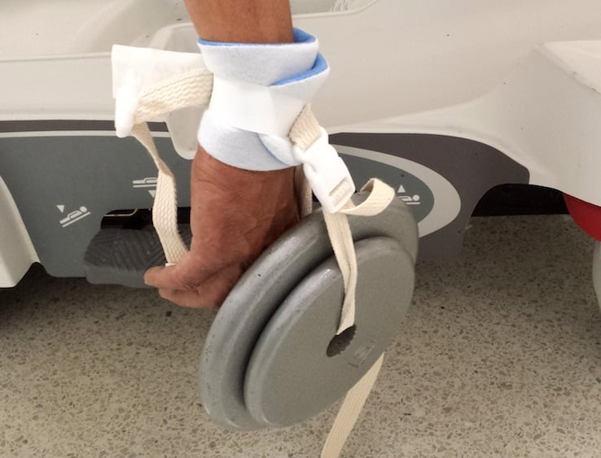
Definition of Restraint
Restraint is defined as any manual method, physical, material, or equipment that immobilizes or reduces the ability of a patient to freely move his or her arms, legs, body or head.

Slide 112
Patient and Family rights regarding Restraint Use
The Department of Health and Human Services document on restraint in the United States clearly outlines the rights of the patients with respect to the use of restraint. It states that seclusion or restraint be used only after the less restrictive means are not effective. To be free from seclusion/restraint is the right of the patient and these coercive measures are to be used only when there is a threat to the life of the patient or the treating staff.

Slide 113
Preparation for using restraints
The use of any type of restraint involves psychological adjustment for the patient and family. If restraint must be used, assist the family members and the patient by explaining the purpose of the restraints, the patient's expected care while restrained, the precautions to be taken to avoid injury, and the temporary and protective aspects of restraints.

Slide 114
Effects of using restraints
The use of restraint is controversial as they have been associated with negative consequences including injury and death.
Effects of restraints to patients:
Physical effects: Panic/fear, Incontinence, Infection, Constipation, Muscle atrophy, and Dehydration.
Emotional effects: Loss of self-esteem, Independence, Dignity, Anger or Agitation, Isolation, and Depression.
Other effects: Pneumonia, Strangulation, and Fall.

Slide 115
Alternatives to using Restraints
Before applying restraint why not try these few alternatives:
1. Orient patients and families to their environment; explain all procedures and treatments.
2. Provide companionship and supervision, use trained sitters or adjust staffing.
3. Offer diversionary activities, such as listening to music or having something to hold.
4. Assign confused or disoriented patient to room near the nurse's station; observe these patients frequently.
5. Use calm, simple statements and physical cues as needed.
6. Use de-escalation, time-outs, and other verbal intervention techniques when managing aggressive behavior.

Slide 116
Alternatives to using Restraints
7. Provide appropriate visual and auditory stimuli (i.e. family pictures, a clock, or a radio).
8. Remove cues that promote leaving (i.e. sight of elevators, stairs, or street clothes).
9. Promote relaxation techniques and normal sleep patterns.
10. Attend to the patient's toileting, food and fluid needs.
11. Camouflage IV lines with clothing, a stockinette, or a kling dressing.
12. Evaluate all medications the patients are receiving, and ensure effective pain management.
13. Reassess the physical status of patients, and review laboratory findings connected with their health.

Slide 117
ICWP Resource Documents
Case Manager Lists – Enhanced and Traditional
ICWP Overall Provider List
ICWP New Provider Training Power point
Frequently used ICD-10 codes
ICWP Case Manager Care Plan Submission Checklist
Sample packet of annual care plan forms
ICWP Medical Review Nurse – Regional Assignments
ICWP UCR Document requirements
Waiver Transfer form – send for waiver to waiver transfers
ICWP procedure codes and rate sheet

Slide 118
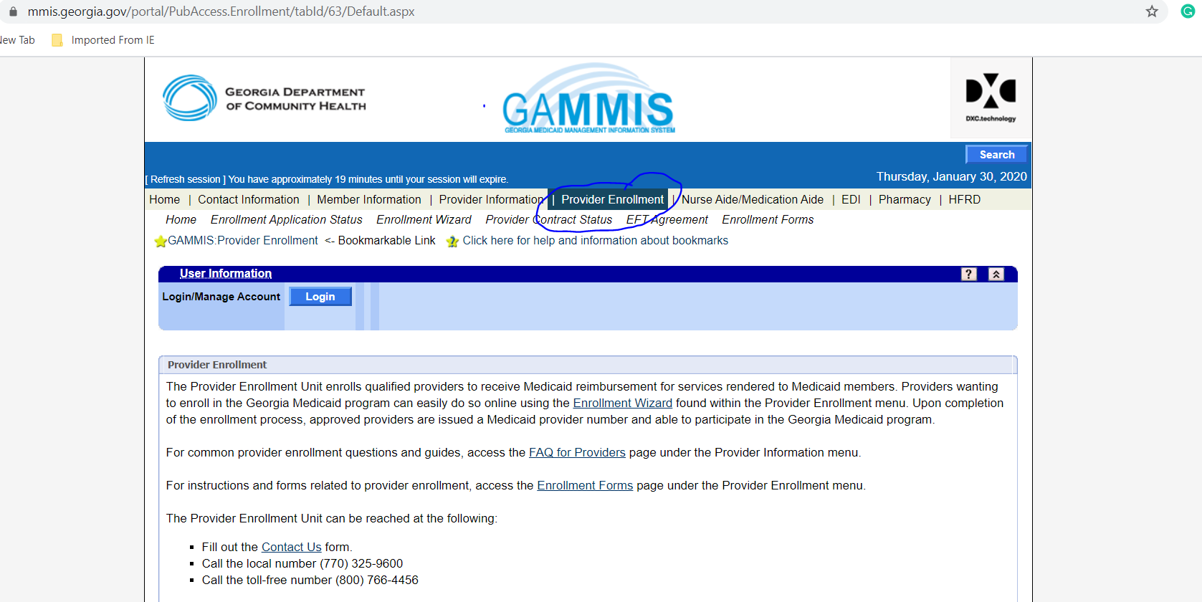
ICWP Provider Enrollment
Alliant Health Solutions DOES NOT manage or process Provider Enrollment. Provider Enrollment is solely managed through the Department of Community Health.
Provider Enrollment starts here

Slide 119
Department of Community Health: ICWP Provider Enrollment
Vonnie Stelly, MCMP-II
Program Consultant/Compliance Auditor-Medicaid Division
Department of Community Health
2 Peachtree St. NW, 37th Floor, Atlanta GA 30303-3159
Office- 404 656-7875
VStelly@dch.ga.gov

Slide 120
Alliant Health Solutions Contacts
Tonja Wragg RN BSN, CCM, MHSc– Manager of Waiver Programs- ICWP/CCSP/SOURCE/NOW/COMP
Tonja.Wragg@AlliantHealth.org
Xan Gatling RN BSN – HCBS resource Nurse
Xan.Gatling@AlliantHealth.org
Tara Smith – Administrative Assistant
Tara.Smith@alliantaso.org

Slide 121
ICWP Medical Review Nurses
Ashley Murray RN Ashley.Murray@AlliantHealth.org – Region 1
Carolyn Bryan RN, BSN Carolyn.Bryan@AlliantHealth.org – Region 2
Region 3 – vacant
Nicole Martinez RN Nicole.Martinez@AlliantHealth.org - Region 4
Shaniece Townsend RN – Shaniece.Townsend@AlliantHealth.org – Region 5

Slide 122
Department of Community Health Contacts
Vonnie Stelley– ICWP Program Consultant -VStelly@dch.ga.gov, 404-656-7875
Carolyn Porter RN CCM– CCSP-Source Program Consultant - carolyn.porter@dch.ga.gov
Marilyn Ellis - NOW/COMP Waiver Program Consultant - mellis@dch.ga.gov

Slide 123
DCH Contact for Claims and Billing
Donna Elrod
Claims Resolution and Prior Authorization Specialist
GA Dept. of Community Health
Medicaid Division
Policy and Provider Services
2 Peachtree St. NW
37th Floor
Atlanta, GA 30303-3159
404-463-1898
Work Cell 470-522-9620
donna.elrod@dch.ga.gov

Slide 124
ICWP New Biller Webinar Training with Gainwell Tech.
Thursday, November 10, 2022
2:00 p.m.
________________________________________________________________________________
Microsoft Teams meeting
Join on your computer, mobile app or room device
Click here to join the meeting
Meeting ID: 225 449 896 983 Passcode: VNQSqu
Download Teams | Join on the web
Or call in (audio only)
+1 470-607-0628,,383158691# United States, Atlanta
Phone Conference ID: 383 158 691#
Find a local number | Reset PIN

Slide 125
Thank You

