Slide 1
2021–2023 Georgia Department
of Community Health Quality Strategy Update
Kelvin Holloway, MD, MBA
Deputy Executive Director/Senior Medical Director
Performance & Care Management Office, Georgia Department of Community Health
and
Kim Elliott, PhD, CPHQ, CHCA, Executive Director
Health Services Advisory Group (HSAG)
Date:

Slide 2
Agenda
Purpose of Updating the Quality Strategy
Quality Strategy Update Team Members
DCH Mission and Vision
Quality Strategy Framework
DCH Plan to Address Disparities
Stakeholder Feedback Process
Quality Strategy Aims, Goals and Objectives
Quality Strategy Timeline

Slide 3
Why is DCH Updating the Quality Strategy?
2016 Medicaid Managed Care Rule: 42 CFR §438.340
States contracting with managed care organizations must draft and implement a written quality strategy for assessing and improving the quality of health care and services furnished by the managed care entities.
The State must review and update its Quality Strategy as needed, but no less than once every three years.

Slide 4
DCH Quality Strategy Update Team
Kelvin Holloway, MD, MBA, Deputy Executive Director/Senior Medical Director, Performance & Care Management Office
Gloria Beecher, DNP, RN, CPHQ, Director, Population Health & Quality Planning Care Management Office
Carla Willis, PhD, MA, Director of Performance, Quality, and Outcomes, Performance & Care Management Office Medical Assistance Plans
DCH office and department subject matter experts
Health Services Advisory Group: Kim Elliott, PhD, MA, CPHQ, CHCA
Health Services Advisory Group: Kari Vanderslice, MBA

Slide 5
Stakeholder Feedback
Consumers
Medical Community
Other Stakeholders

Slide 6
Stakeholder Review and Feedback Requested
State priorities and areas of concern for the population served by the Medicaid program
Aims, goals and objectives
Performance improvement projects (SMART) and interventions to improve access, quality, or timeliness of care for CMO members
Plan to identify, evaluate, and reduce health disparities
Any other area of the quality strategy

Slide 7
DCH Mission, Vision and Values

Slide 8
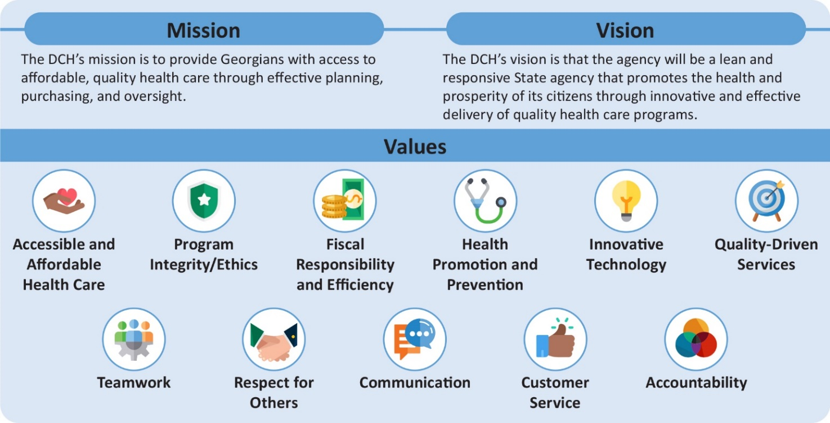
DCH Mission and Vision

Slide 9
Quality Strategy Framework
Three Aims
Improve health, services and experience
Smarter spending
HCBS-LTSS: Improve health and services

Slide 10
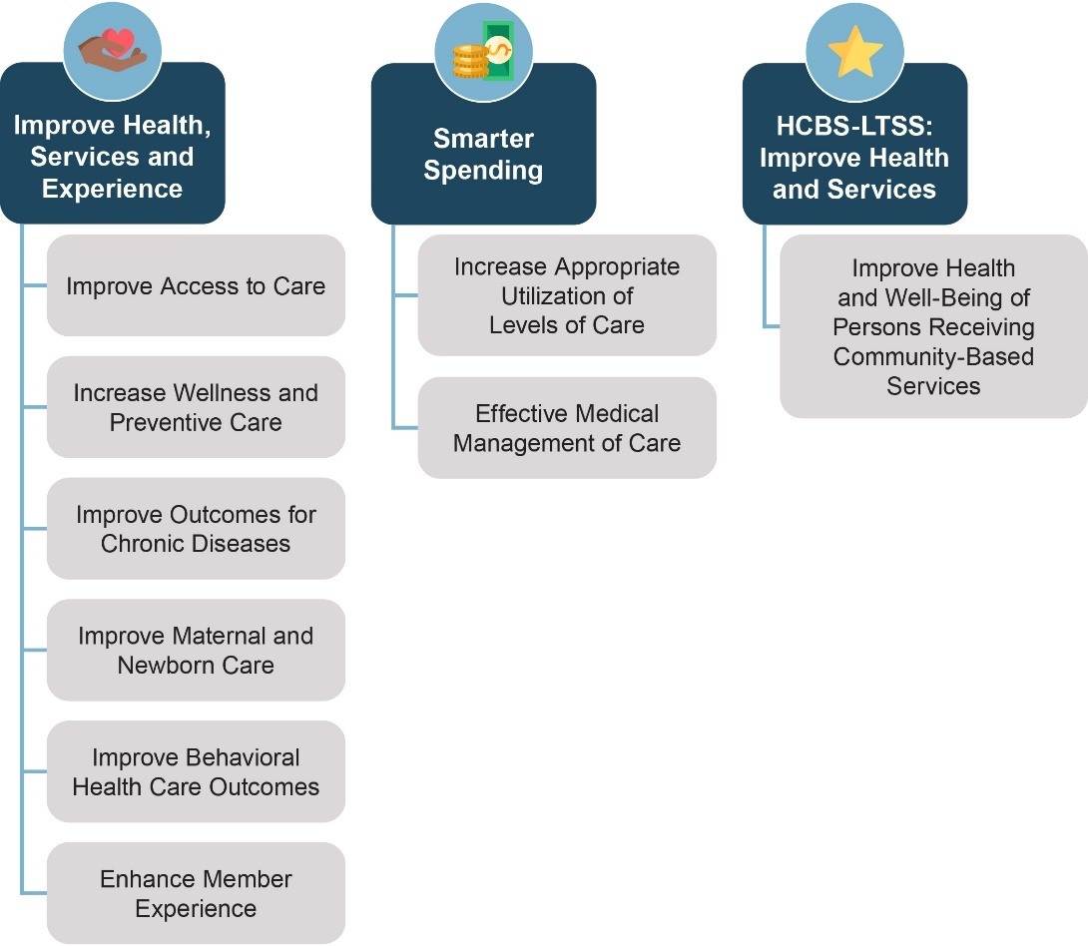
Quality Strategy Framework Goals

Slide 11
Plan to Address Health Disparities
Race
Ethnicity
Age
Gender
Language
Special needs
Geographic location
Disability status

Slide 12
Plan to Address Health Disparities
1. Make health equity a strategic priority
2. Develop structure and processes to support health equity work
3. Deploy specific strategies to address the multiple SDOH for direct impact
4. Develop partnerships with community and managed care organizations

Slide 13
DCH 2021-2023 Quality Strategy
Aims
Goals
Objectives

Slide 14
Quality Strategy Aims, Goals, and Objectives
Aim 1: Improve Health, Services & Experience
Goal 1.1: Improve Access to Care
Objectives:
Increase number of persons enrolled in health benefits under the Pathway program by enrolling a minimum of 15,000 new members per year in CY 2022 and 2023
Increase annual number of postpartum care visits to perform at or above the HEDIS 50th percentile by the end of CY 2023
Increase number of children receiving well-child and preventive visits to perform at or above the HEDIS 50th percentile by the end of CY 2023
Increase number of adults receiving well- and preventive visits to perform at or above the HEDIS 50th percentile by the end of CY 2023
Increase percentage of membership Getting Needed Care to perform at or above the 67th percentile by the end of CY 2023

Slide 15
Quality Strategy Aims, Goals, and Objectives
Aim 1: Improve Health, Services & Experience
Goal 1.2: Increase Wellness and Preventive Care
Objectives:
Increase the percentage of children less than 21 years of age that receive preventive oral health services to perform at or above the CMCS 75th percentile by the end of CY 2023
Increase overall rate of immunizations and vaccinations across all ages and populations to perform at or above the HEDIS 90th percentile by the end of CY 2023
Increase the number of breast cancer screenings for qualified women to perform at or above the HEDIS 75th percentile by the end of CY 2023
Increase the number of qualified women receiving cervical cancer screenings at or above the HEDIS 75th national percentile by the end of 2023

Slide 16
Quality Strategy Aims, Goals, and Objectives
Aim 1: Improve Health, Services & Experience
Goal 1.3: Improve Outcomes for Chronic Diseases
Objectives:
Increase the number of members with controlled HbA1c to perform at or above the HEDIS national 50th percentile by the end of 2023
Decrease annual hospital admission rate for members with heart failure to perform at or above the CMCS 75th percentile by the end of CY 2023
Increase number of members with controlled high blood pressure to perform at or above the HEDIS national 50th percentile by the end of CY 2023

Slide 17
Quality Strategy Aims, Goals, and Objectives
Aim 1: Improve Health, Services & Experience
Goal 1.4: Improve Maternal and Newborn Care
Objectives:
Decrease annual maternal mortality rate by 3% by the end of CY 2023
Decrease number of live births with low birth weight to perform at or above the CMCS 75th percentile by the end of CY 2023

Slide 18
Quality Strategy Aims, Goals, and Objectives
Aim 1: Improve Health, Services & Experience
Goal 1.5: Improve Behavioral Health Care Outcomes
Objectives:
Decrease annual behavioral health 30-day readmission rate to perform at or above the HEDIS 50th percentile by the end of CY 2023
Increase the number of adolescents screened for follow-up for depression to perform at or above the HEDIS 50th percentile by the end of CY 2023
Increase the number of adults screened and receiving follow-up for depression to perform at or above the HEDIS 50th percentile by the end of CY 2023

Slide 19
Quality Strategy Aims, Goals, and Objectives
Aim 1: Improve Health, Services & Experience
Goal 1.6: Enhance Member Experience
Objective:
Increase annual CAHPS Overall Rating of Health Plan by 5% by the end of CY 2023

Slide 20
Quality Strategy Aims, Goals, and Objectives
Aim 2: Smarter Spending
Goal 2.1: Increase Appropriate Utilization of Levels of Care
Objective:
Decrease hospitalizations and ER utilization rates to perform at or above the HEDIS 50th percentile by the end of CY 2023

Slide 21
Quality Strategy Aims, Goals, and Objectives
Aim 2: Smarter Spending
Goal 2.2: Effective Medical Management of Care
Objective:
Increase telemedicine visits by 10% for members residing in select Medically Underserved Areas (MUA) by the end of CY 2023

Slide 22
Quality Strategy Aims, Goals, and Objectives
Aim 3: HCBS-LTSS: Improve Health and Services
Goal 3.1: Improve Health and Well-Being of Persons Receiving Community-Based Services
Objective:
Increase the number of Waiver participants receiving timely follow-up post hospitalization by 3% by the end of CY 2022 and CY 2023

Slide 23
Quality Strategy Timeline

Slide 24
Quality Strategy Timeline
9/14/2020: Quality strategy update initiated
3/1/2021: Draft quality strategy posted for public comment
3/1/2021–3/31/2021: Stakeholder input received
5/1/2021: Public comments reviewed and considered
5/31/2021: Final quality strategy submitted to CMS

Slide 25
Stakeholder Feedback is Encouraged

Slide 26
Please submit feedback to:
DCHqualitystrategyfeedback@hsag.com

